Slide 1
Amenity- The Conflict and Benefit Between Nature and Human Activity

Slide 2
What is Amenity
Something, such as a swimming pool or shopping centre, that is intended to make life more pleasant or comfortable for the people in a town, hotel, or other place: (Cambridge Dictionary)

Slide 3
Types of Amenity Landscape
Playing fields
Parks
Ornamental gardens
Woodland
Moorland
Rivers
Ponds
Lakes

Slide 4
Two Important Aspects
Managed
Public Access

Slide 5
Value
Mental and physical health of the users
Historic value (stories to tell)

Slide 6
Other Considerations
Biodiversity and Natural Capital
Public pressure on the resource
Management costs
Health and safety

Slide 7
Example 1, Parkers Piece

Slide 8
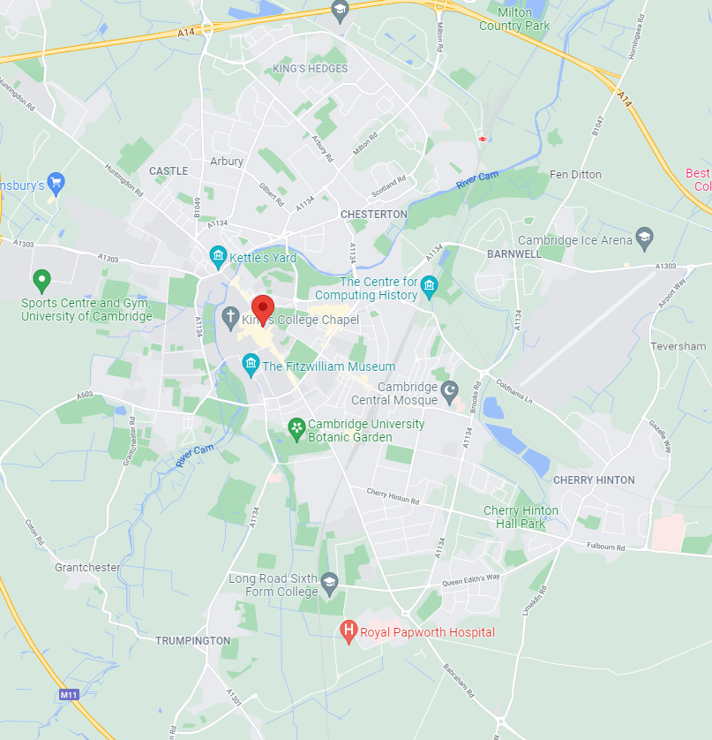
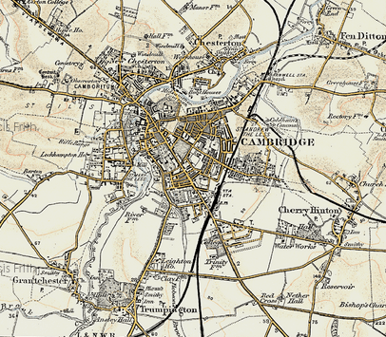
Cambridge 1899 - 2021

Slide 9
Management and Ownership
Transferred from Trinity College to ‘Corporation’ property (City Council) in 1613
To be managed as Common Land
Subject to byelaws

Slide 10
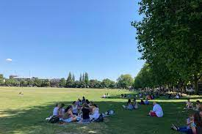
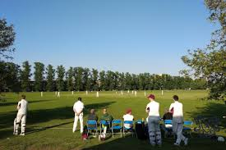
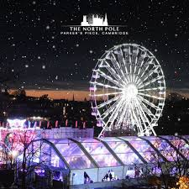
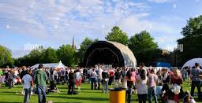
Current Use
For hire for events
Organised sports
General public use

Slide 11
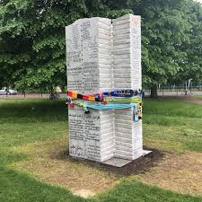
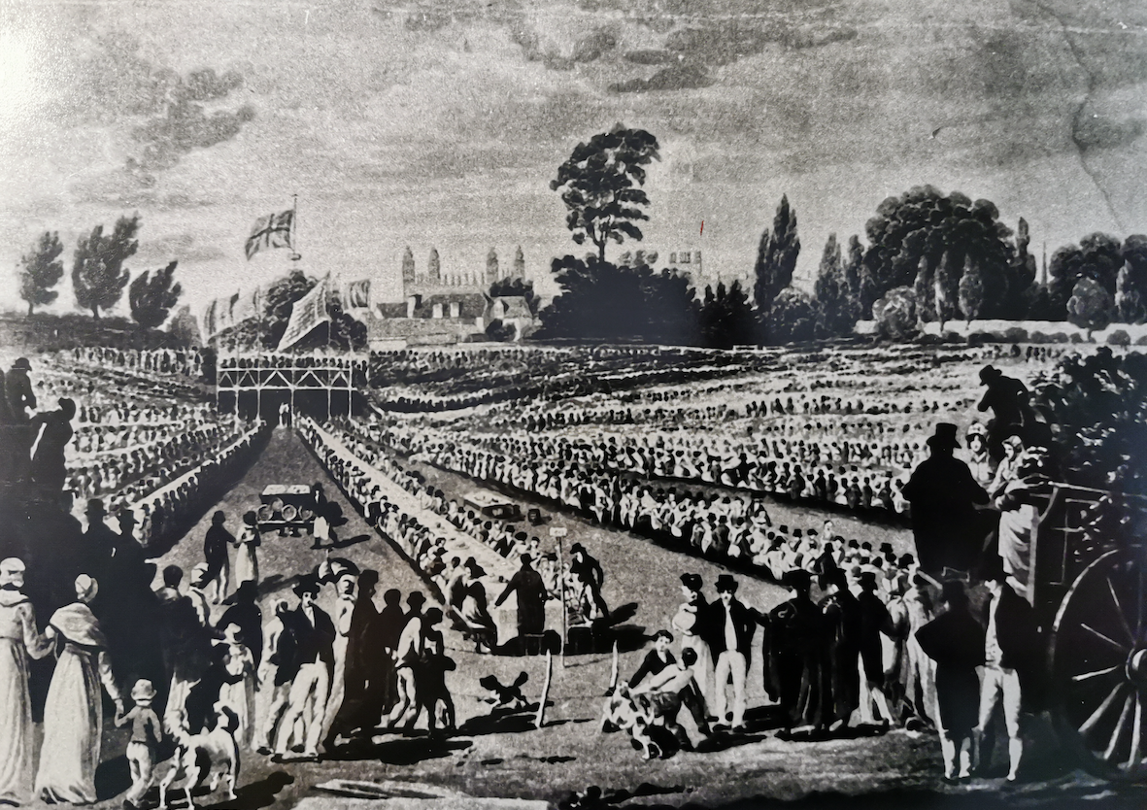
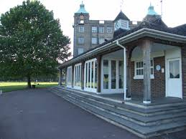
Historic Significance
Significant commemorations since at least 1814
Creation of Association Football
Hobbs pavillion

Slide 12
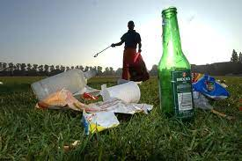
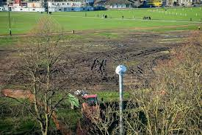
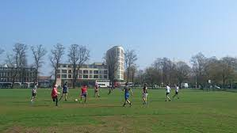
Significant Pressures
Damage to grass following events
Excessive use
Litter

Slide 13
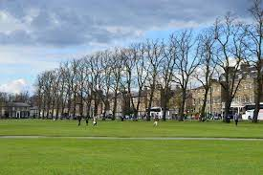
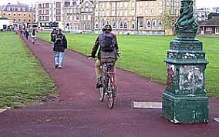
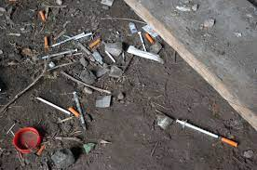
Health and Safety
Mature Trees
Cyclists and pedestrians
Hard ball sports
Drug misuse

Slide 14
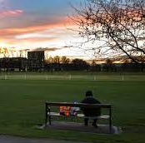
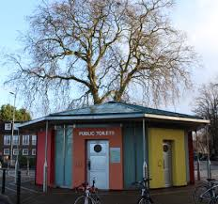
Additional Facilities
Public toilets with needle bins
Cricket changing facilities
Benches

Slide 15
Management Costs
Grass maintenance
Buildings maintenance
Tree maintenance
Litter removal
Biodiversity improvements

Slide 16
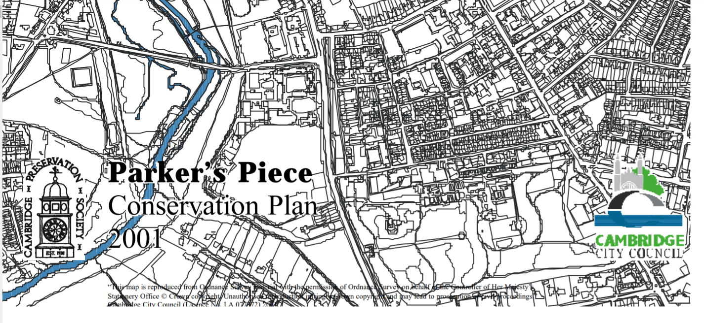
The Future (https://www.cambridge.gov.uk/media/5778/parkers-piece-conservation-plan.pdf)

Slide 17
Example 2, Grantchester Meadows

Slide 18
Cambridge 1899 - 2021

Slide 19
Management and Ownership
Land owned by King’s College Cambridge
Managed by the college and Trumpington Farm which has grazing rites
Also a public bridleway
River owned by ‘The Crown’
River managed by the Environment Agency on behalf of DEFRA
Subject to byelaws

Slide 20
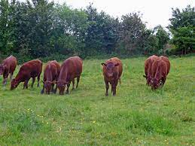
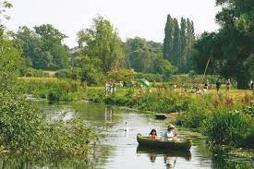
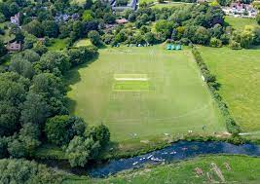
Current Use
Farming
Organised sport
General public use

Slide 21
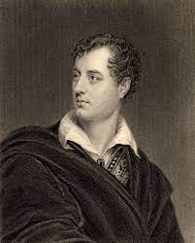
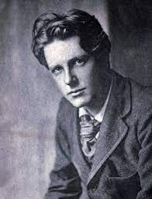
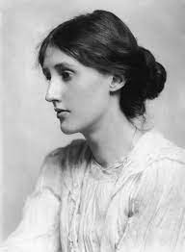
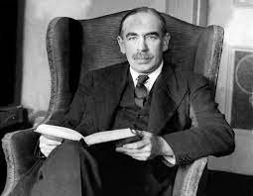
Historic Significance
Favourite haunt of Lord Byron, Rupert Brooke, Virginia Wolf, Maynard Keynes and others

Slide 22
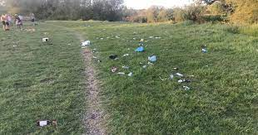
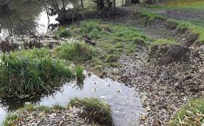
Significant Pressures
Litter
Bank erosion

Slide 23
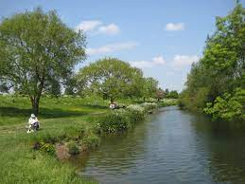
Health and Safety
Mature Trees
Drug misuse
River water quality
Drowning

Slide 24
Additional Facilities
None!

Slide 25
Management Costs
River bank maintenance
Tree maintenance
Litter removal
Biodiversity improvements

Slide 26
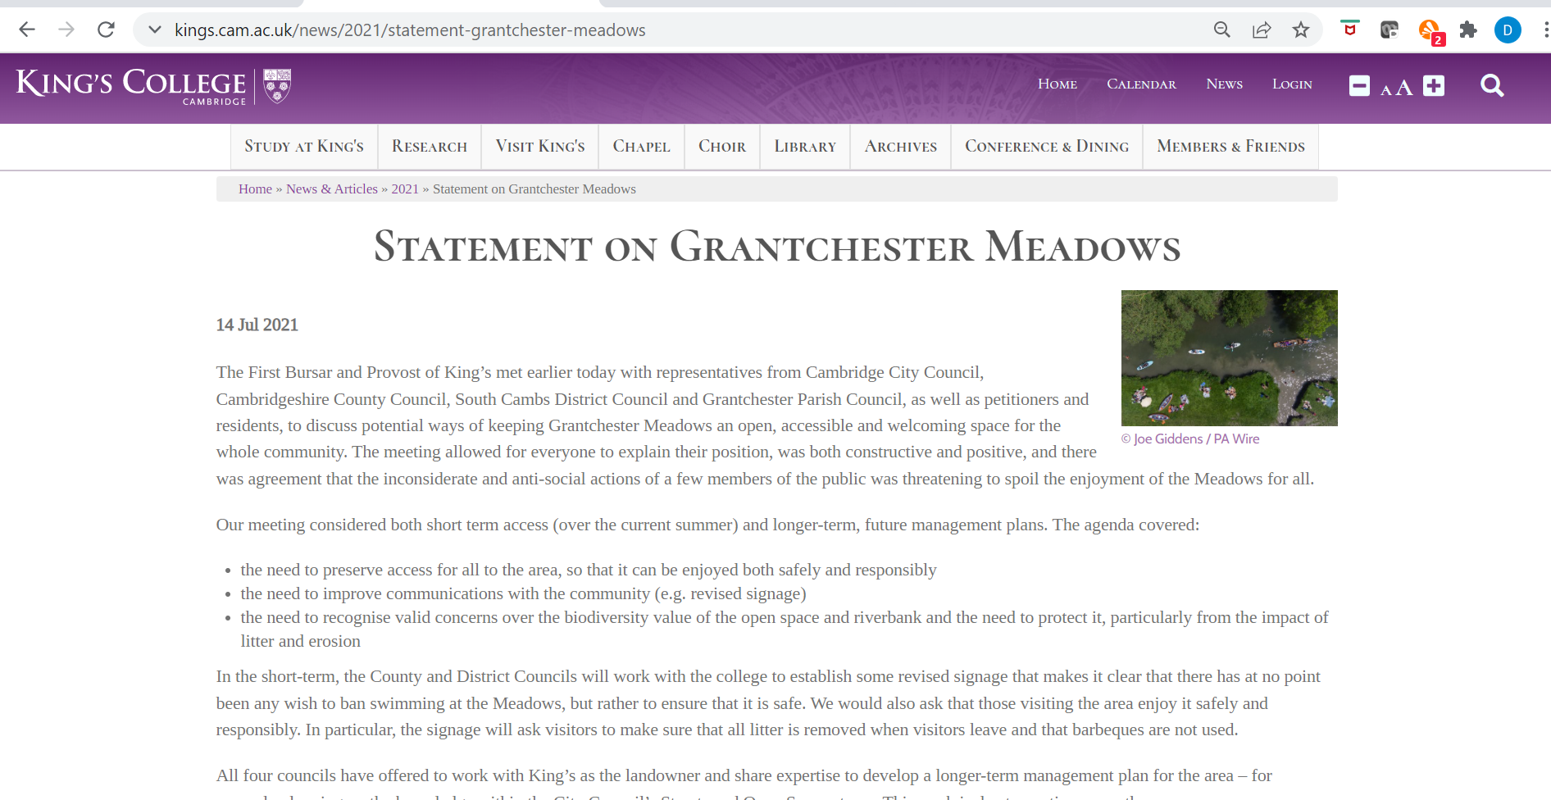
The Future (https://www.kings.cam.ac.uk/news/2021/statement-grantchester-meadows)

